Slide 1

2
0
AMUSEMENT PARK GUEST ANALYSIS
2
1
DATA ANALYSIS AND VISUALIZATION PROJECT

Slide 2
Part 01
Define Action plan Component
“
Part 02
Table of
content
Develop Action Plan
Part 03
”
Domain Effect Result

Slide 3
1
Action Plan Component
Key component when develop an action plan

Slide 4
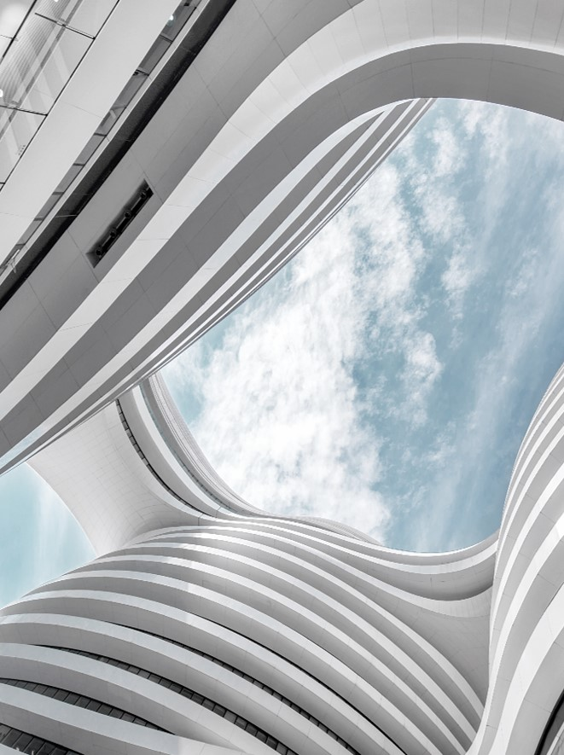
Develop Action Plan
Define Objective, KPI, Stakeholder
Objective / Goal
achieve target for both short term and long term
Stakeholder
possible stakeholder react
who effect by implement action plan
Key Performance Indicator
action effect on KPI
keep track and monitor change
Perform post-implementation evaluation and subsequent analysis

Slide 5
2
Action Plan
List out key component

Slide 6


Objective
KPI
(Key Performance Index)
Stakeholder
Identify reason for deduction of purchase
Suggestion feasible solution/action which increase profit
Choose top 2 indicator
Analysis the distance between food court and play area related to profit (45%)
Analysis the effect of policy change for pass-holders (35%)
Concierge Manager
Business Manager
Food Manager
Facility Manager
Children Programming Manager
Season pass holder
Regular pass holder

Slide 7
3
Domain Effect
Perform a post-implementation and subsequence analysis

Slide 8
DISTANCE EFFECT
Action and Consequence
reduce delay -> reduce waiting line and meal waiting time to increase customer
reduce obstacle in shop -> help customer more focus on select food
spend all $
keep the amount of spend of food
compare to other activities
Distance- Shop
Distance- Character Event
Action:
Increase entertain -> set up character event in different location and time in order to increase time of customer stay longer in park
Provide serve meal -> provide meal while they watch character even to attract more customer
Distance- Fence
Action:
reduce barricade -> help customer quick access to food zone
Increase pathway -> put sign help customer identify the zone

Slide 9
POLICY EFFECT
Policy – Cooler Allowed
Policy – Re-Entry
Action:
allowed cooler/drink in the park -> increase more customer to coming and save their spend on drink which lead them spend more on activities and meal
Action:
allowed re-entry-> increase more customer to coming after meal or the customer who live close by they can have coming to visit afterward on the day.

